Slide 1
基于语义分割和迁移学习的新冠肺炎CT影像识别模型
10172100123 刘颖凡
10174102103 熊双宇

Slide 2
Contents
1
Introduction
2
Framework & Datasets
3
Methodology
4
Result
5
Discussion

Slide 3
CONTENT
01
Introduction

Slide 4
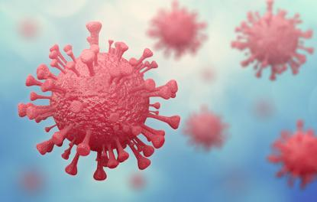
Introduction
COVID-19
Challenge of the world
Strong Transmissibility
Wide Spreading
High
Urgent & Important Task
Effective Detection for Novel Coronavirus
Notes:
2020 年初爆发的新冠肺炎由于其传播性强, 传播人群广, 危害性高等特点，给世界人民带来了前所未有的挑战. 如何有效的判断患者是否患有新冠肺炎, 及时阻止病毒携带者的扩散, 避免造成更多人的感染,是医疗工作者所面对的艰巨的任务. 目前, 针对新型冠状病毒的检测最准确的手段是核酸检测, 然而, 核酸检测需要使用试剂, 且单个标本的检测时间约为 2-3 小时, 在批量检测时甚至需花费 8-10 小时才可得出结果, 在疫情初期大规模人群排查的情景下来讲, 是一笔巨大的时间和经济上的消耗. 为此, 部分研究者提出,如果能够直接通过肺部 CT 影像识别出是否携带有新冠病毒, 将大大节省人力和财力, 提高防控工作的效率.

Slide 5
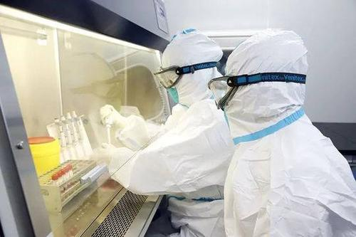
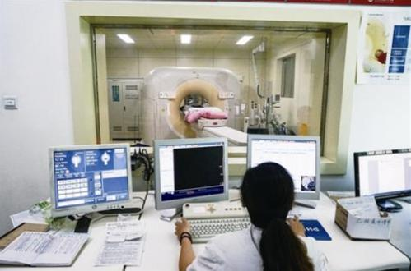
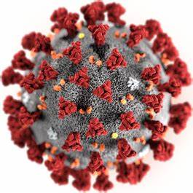
Introduction
Novel Coronavirus Detection
✓ The most accurate
✓ Less time, Lower cost
✗ Time-consuming
✗ High Cost
Lack of Experience
Lack of Infected Samples
Nucleic Acid Testing
Lung CT Scans Images
Notes:
2020 年初爆发的新冠肺炎由于其传播性强, 传播人群广, 危害性高等特点，给世界人民带来了前所未有的挑战. 如何有效的判断患者是否患有新冠肺炎, 及时阻止病毒携带者的扩散, 避免造成更多人的感染,是医疗工作者所面对的艰巨的任务. 目前, 针对新型冠状病毒的检测最准确的手段是核酸检测, 然而, 核酸检测需要使用试剂, 且单个标本的检测时间约为 2-3 小时, 在批量检测时甚至需花费 8-10 小时才可得出结果, 在疫情初期大规模人群排查的情景下来讲, 是一笔巨大的时间和经济上的消耗. 为此, 部分研究者提出,如果能够直接通过肺部 CT 影像识别出是否携带有新冠病毒, 将大大节省人力和财力, 提高防控工作的效率.

Slide 6
CONTENT
02
Framework
&
Datasets

Slide 7
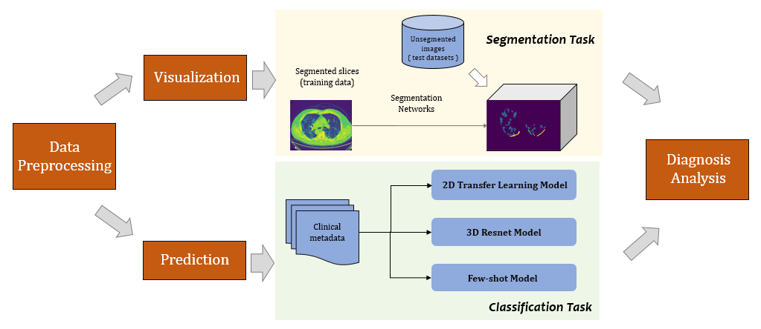
Framework

Slide 8
Datasets
1. COVID-19 CT Segmentation Dataset
40+ subjects, 512 * 512 * 100 array for all
2. 2019 Novel Coronavirus Resource (2019nCoVR)
NCP-Data: 336 subjects, 512 * 512 * [40-100] images per subject
Normal-Data: 165 subjects, 512 * 512 * [40-100] images per subject
3. UCSD CT Scan Dataset about COVID-19
349 images from 300+ subjects, 512 * 512 per image
Notes:
novel coronavirus pneumonia (NCP)
common pneumonia and normal controls.

Slide 9
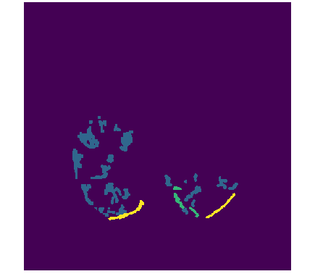
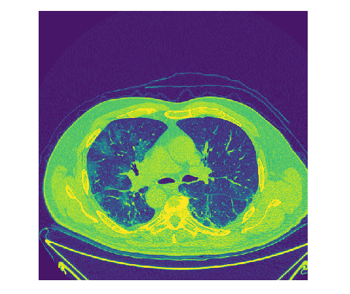
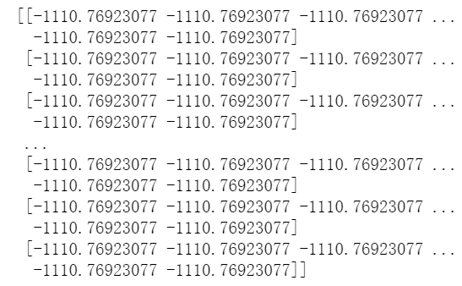
Datasets
COVID-19 CT Segmentation Dataset
Data Matrix
Origin
Mask
■ ground-glass (=1)
■ consolidation (=2)
■ pleural effusion (=3)
Notes:
ground-glass: 毛玻璃(1)
它是一种不模糊的混浊物，并不能掩盖支气管结构或肺血管，表明肺内部分空隙被渗出物或渗出物充满，肺间质增厚或肺泡部分塌陷。
Consolidation: 实变(2)
肺实变是通常可压缩的肺组织区域充满液体而不是空气。这种情况的特征是正常通气的肺硬化(肿胀或硬化的正常软组织)。这被认为是一种放射学征象
pleural effusion: 胸腔积液
胸腔积液，有时被称为“肺积水”，是在肺外胸膜层之间积聚的多余液体。胸膜是排列在肺和胸腔内部的薄膜，起到润滑和促进呼吸的作用。

Slide 10
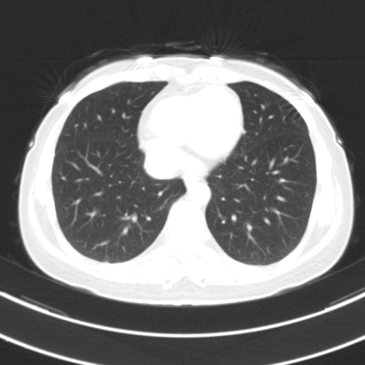
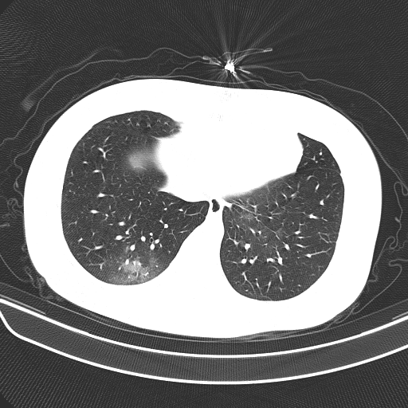
Datasets
2019 Novel Coronavirus Resource (2019nCoVR)
Normal Subject
NCP Subject
Notes:
novel coronavirus pneumonia (NCP)
common pneumonia and normal controls.

Slide 11
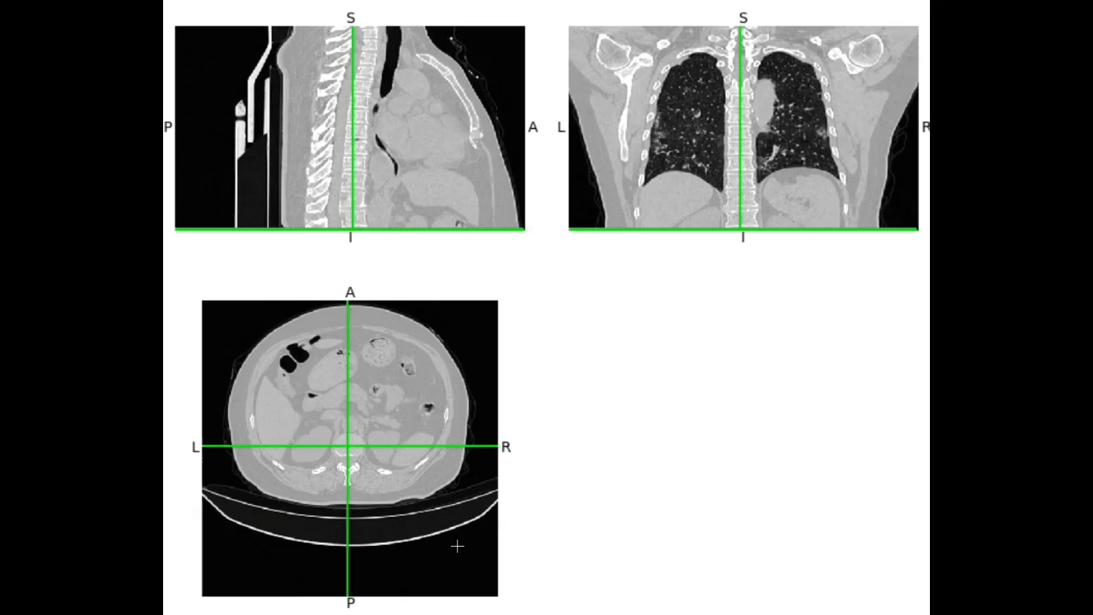
Datasets
CT Scan Dataset about COVID-19
Lung CT Image for one subject
Notes:
novel coronavirus pneumonia (NCP)
common pneumonia and normal controls.

Slide 12
CONTENT
03
Methodology

Slide 13
Methodology
Preprocessing
Segmentation
Classification
Transfer Learning & Data Augmentation
3D Resnet
Notes:
novel coronavirus pneumonia (NCP)
common pneumonia and normal controls.

Slide 14
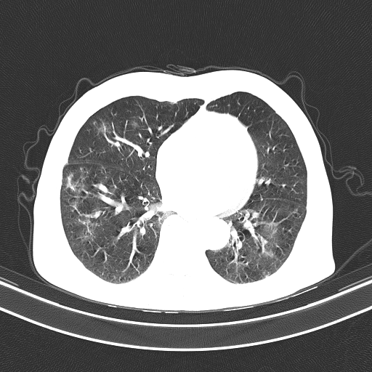
Methodology
1. Preprocessing
2D Data Set
pick one photo from one volume
512
64
512
512
CT volumes
512

Slide 15
Methodology
1. Preprocessing
3D Data Set
pick core photos from one volume
64
4
512
512
CT volumes
512
512

Slide 16
Methodology
2. Two-Stage Segmentation Network
COVID-19 CT Segmentation Dataset
labels:
id_1: 0
id_2: 1
…
Predict label [COVID-19 CT ]
Input(512, 512)
Output(3, 64, 128, 128)
■ ground-glass (=1)
■ consolidation (=2)
■ pleural effusion (=3)

Slide 17
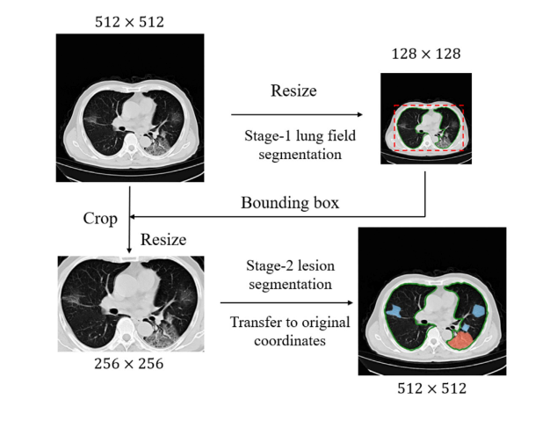
Methodology
Maxpooling
Conv2d
2. Two-Stage Segmentation Network
BatchNorm2d
* 2
ReLU
COVID-19 CT Segmentation Dataset
Pre Net： Resize& Crop
Unet, FCN, DeepLab
Training Net：Segnet & Upsampling
Notes:
由于一个人的CT扫描通常由多个切片组成，厚度从50 (5mm)到200 (1mm)不等，对临床实时应用具有一定的挑战性。为了使模型能够专注于输入图像中具有医学意义的区域，我们将分割框架制定为两阶段分割方案，这将显著降低计算成本

Slide 18
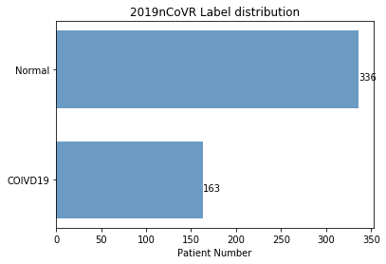
Methodology
3. Classification
2019nCoVR
labels:
COVID19: 0
Normal: 1
Predict label [2019nCoVR]
Input(512, 512)
Output(1,)

Slide 19
Methodology
3. Classification
3D Input:
4
2019nCoVR
labels:
COVID19: 0
Normal: 1
Predict label [2019nCoVR]
Input(512, 512)
Output(1,)
512
512
Predict label [2019nCoVR]
Input(4, 512, 512, 3)
Output(1,)

Slide 20
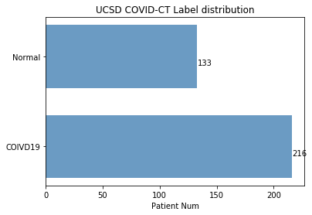
Methodology
3. Classification
b. UCSD COVID-CT
labels:
COVID19: 0
Normal: 1
Predict label [UCSD COVID-CT]
Input(512, 512)
Output(1,)

Slide 21
Methodology
4. Transfer learning & Data Augmentation
Contrasive Self-Supervision Learning for the Transfer learning
CSSL:
Performs data augmentation
Judge whether two images created via augmentation are augments of the same original image.
Data set: COVID-CT with no labels
《Sample-Efficient Deep Learning for COVID-19 Diagnosis Based on CT Scans》

Slide 22
Methodology
4. Transfer learning & Data Augmentation
Contrasive Self-Supervision Learning for the Transfer learning
CSSL
Trans:
Data set: ImageNet & Lung Nodule Maligancy dataset
Dense-Net129: Fine-tune the weights on both the CTs and the class labels by optimizing the classification loss.
《Sample-Efficient Deep Learning for COVID-19 Diagnosis Based on CT Scans》

Slide 23
Methodology
4. Transfer learning & Data Augmentation
Data Augmentation
affine transformation
crop
flip
《Sample-Efficient Deep Learning for COVID-19 Diagnosis Based on CT Scans》

Slide 24
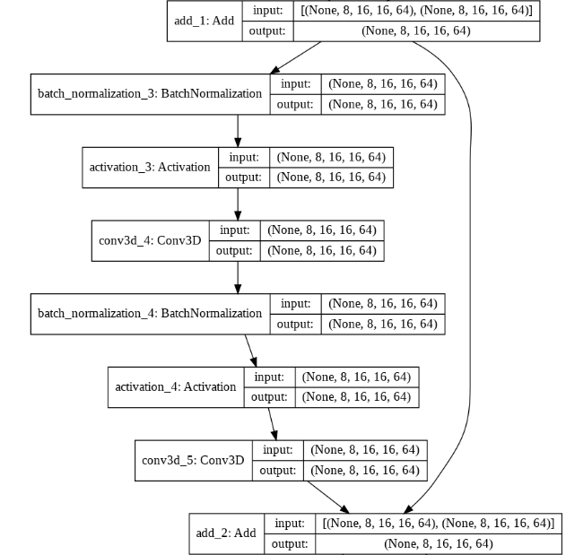
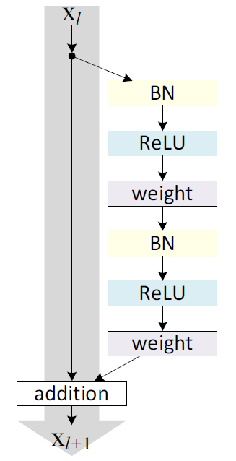
Methodology
5. 3D Resnet
3D Resnet 18
Residual unit
Identity mapping
Extend for volume-to-volume prediction

Slide 25
CONTENT
04
Result

Slide 26
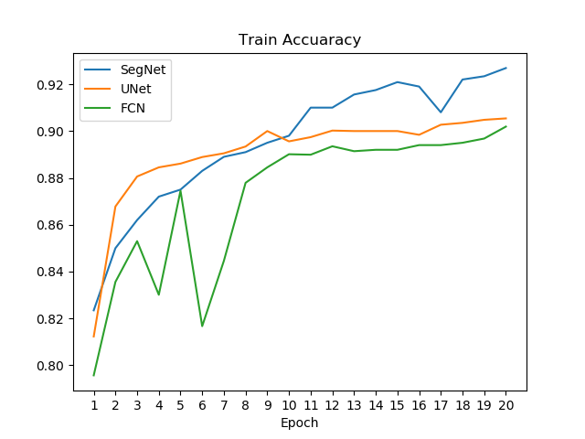
Task 1
Using CT images to generate segmentation
COVID-19 CT Segmentation Dataset
Network: Segnet
Activation: softmax
Loss: CrossEntropyLoss
Input:(512, 512)
Output:(512, 512)

Slide 27
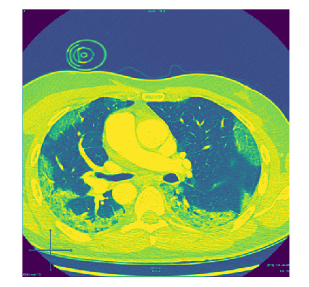



Task 1
Using CT images to generate segmentation
CT image
Segmented CT image
SegNet
UNet
FCN

Slide 28
Task 2
Using deep learning to find correlation between COVID19 & Normal
2D CT -- Classification
3D CT -- Classification

Slide 29
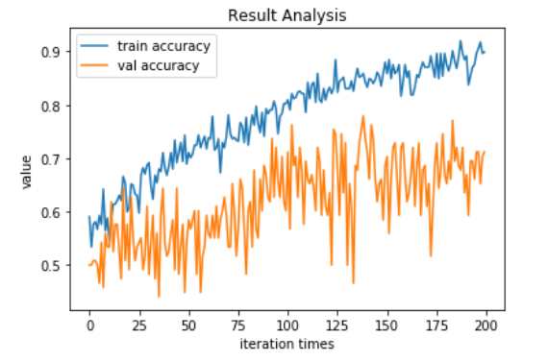
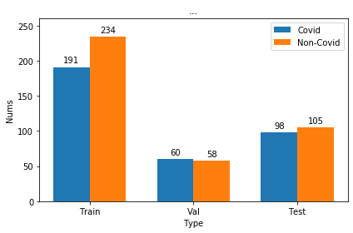
Task 2
2D CT to classification
UCSD COVID19-CT dataset 387 subjects
COVID19: 349 imgs
Normal: 397 imgs
Network: Pretrained
DenseNet 129

Slide 30
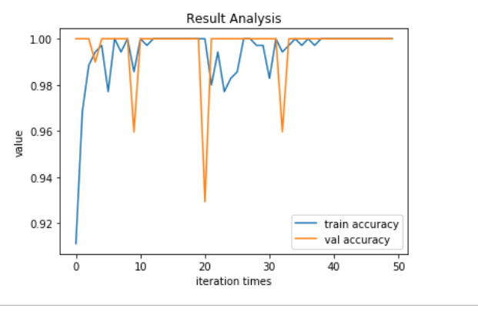
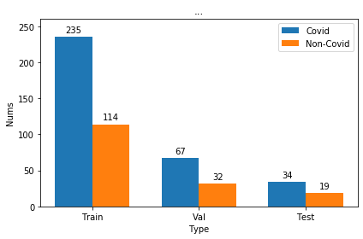
Task 2
3D CT to classification
2019nCoVR dataset 499 subjects
COVID19: 336 subject
Normal: 163 subject
Network: 3D Resnet18

Slide 31
CONTENT
05
Discussion

Slide 32
Discussion
For 2D transfer learning
.
Domain difference
Segmentation -> Cassification
For 3D CT images
Occupy 200+G
Long training time(10-15 mins per epoch)
Few-shot scene-specific adaptive model
try on current datasets
compare

Slide 33
Thanks Q & A

